Slide 1
Using R in the British Heart Foundation
NHS-R conference
November 2020
@katycheema
Notes:
Who am I?
DISCLAIMER
I am not an R expert, I am personally an enthusiastic dabbler but represent a team with amazing skills- I hope to do them justice.
My aim today is less to teach you anything new, but more to share our experiences and challenges and hopefully be useful to those just starting out on the R journey in their organisations, or find themselves needing to make a case for change.

Slide 2

v
7,400,000
We want
better ways to identify people at risk and help people avoid disease
^{million people are} living with heart and circulatory diseases in the UK today – that’s ^{more than} ^{double the number} ^{of people living with cancer} ^{and Alzheimer’s disease} ^{combined}
v
Notes:
45,000 premature deaths each year
Total cost to UK economy- estimated 19bn
BHF has been around for about 60 years
Primary purpose is to fund research into heart and circulatory disease- heart disease, stroke, diabetes, vascular dementia, risk factors
But we also seek to influence policy and health services, provide information and support to people with HCD and seek to take the results of the research we fund to realise tangible benefit for patients and the public

Slide 3
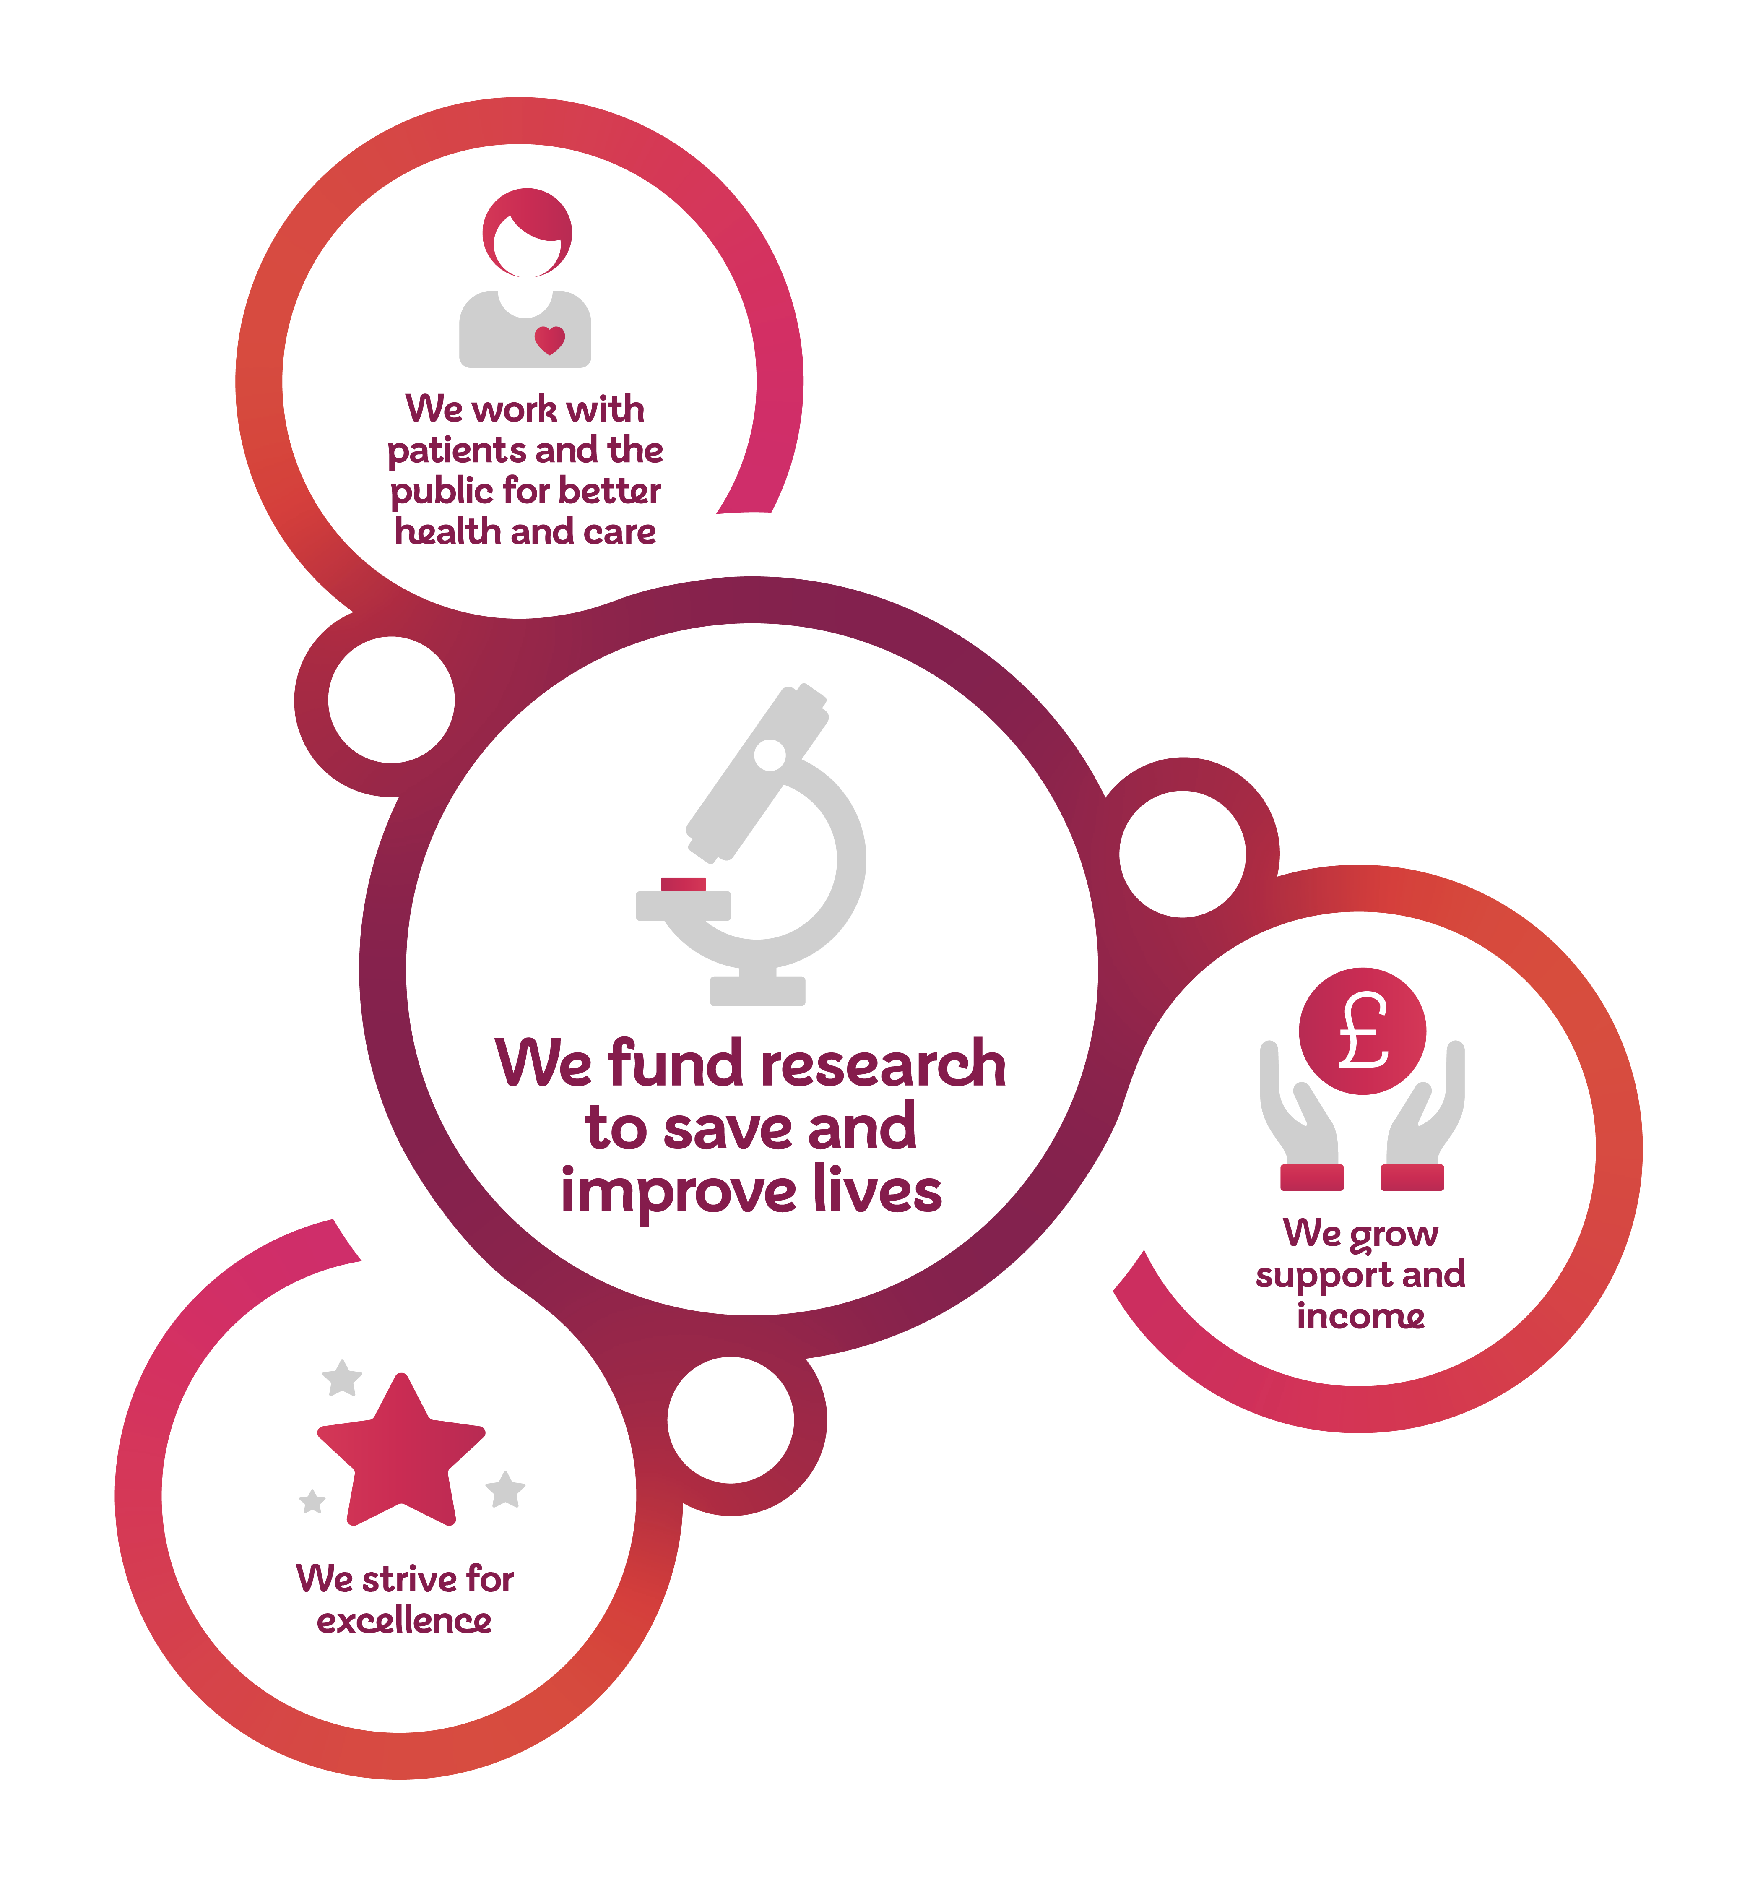
Notes:
How do we do this….
Four key strategic pillars and intelligence underpins each one of them
Funding Research- Research intelligence helps us understand the research landscape and our place in it. Health intelligence enables us to assess the impact of our research as it is implemented in care
Working with patients and the public- Customer intelligence ensures we understand the needs of our customers and can develop our offers to meet them
Health intelligence works with consumer intelligence to provide an holistic picture of need, met and unmet
Growing support and income- Supporter and marketing intelligence to support out fundraising strategies
Strive for excellence- Research, health and consumer intelligence teams contribute to our understanding of impact
This means we have quite a range of different data and data sets to access; myself and my team are more focussed in the Patient and Public side, so most of our examples come from there but we’re also using R across the whole business……

Slide 4
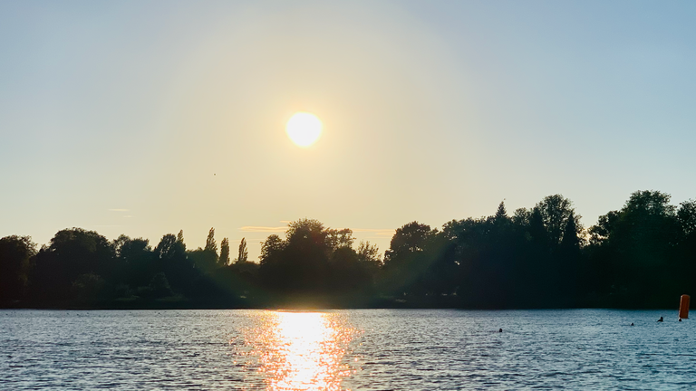
Notes:
Last year, before I started at the BHF I took a staggering 4 weeks off paid work. I did a lot on those 4 weeks- festivals (remember them?!) – including setting myself some fairly nerdy self improvement goals. One of these was to finally open the pages of ‘R for Data Science’ (Hadley Wickham and Garrett Grolemund) and teach myself some R basics which I hadn’t quite got round to doing in my old job, using some data from my local gym (long story). Another one was to try open water swimming.
I can hear your eyes rolling; OK, what does R and open water swimming have in common? Well, right now, when its more accurately described as bloody-freezing-cold water swimming, quite a lot…….
Let me explain.
There are four stages to cold water swimming and they mirror the stages we went (and indeed are still) going through with R at the BHF.

Slide 5
Stage 1: why on earth am I doing this?
That water looks really cold, I just left a warm cosy house behind me and….hang on…… what exactly do those ducks think they are doing??
Notes:
That water looks bloody cold, I just left a warm cosy house behind me and….hang on…… what exactly do those ducks think they are doing??
Answering the ‘why’ question.
At the BHF we were fortunate that making the case for change in terms of expanding our analytical toolbox came at an auspicious time as we started to develop our health intelligence strategy but it was clear that there were a number of compelling reasons to get to grips with R as a tool that had the potential to help us solve a number of problems, many of which will be familiar to you. I call them the 3 bigs……
Big spreadsheets- unstable and frankly baffling unless you’re the one who built them
Big ambitions- a clever bunch of people who wanted to do more with the data available to them
Big capacity issues- we needed to streamline the time we spent on big spreadsheets to enable to big ambitions
The advent of the pandemic only exacerbated this- demand for intelligence product and reporting increased, enabling us to meet many of the big ambitions but laying bare the issues with big capacity and the instability of big spreadsheets.
Much of this stage is psychological, just like with the cold water, and is largely a fear of the unknown; its helped by seeing people already paddling around in the lake as it were. In this case we had a lot of inspiration, not least some of my former colleagues in the NHS, partners in the charity sector, some of our BHF researchers and of course the rallying cries from Ben Goldacre, APHA and our very own community. More on community later.

Slide 6
Stage 2: dipping in your toes
I’m right, that water is *$!@&* cold……but I don’t appear to have frostbite…….yet
Notes:
I’m right, that water is bloody cold……but I don’t appear to have frostbite
It’s probably fair to reflect that initially, at the BHF our use of R was more or less piecemeal. The odd bit of analysis here or there, as much to develop our own skills or explore a new package as much as anything else. Which I think was fair enough.
Some of the team were better versed in it usage than others, and used it more extensively. We’ve even dipped our toes into Shiny – more on that later
Here’s some examples of one-off things we did with R……

Slide 7
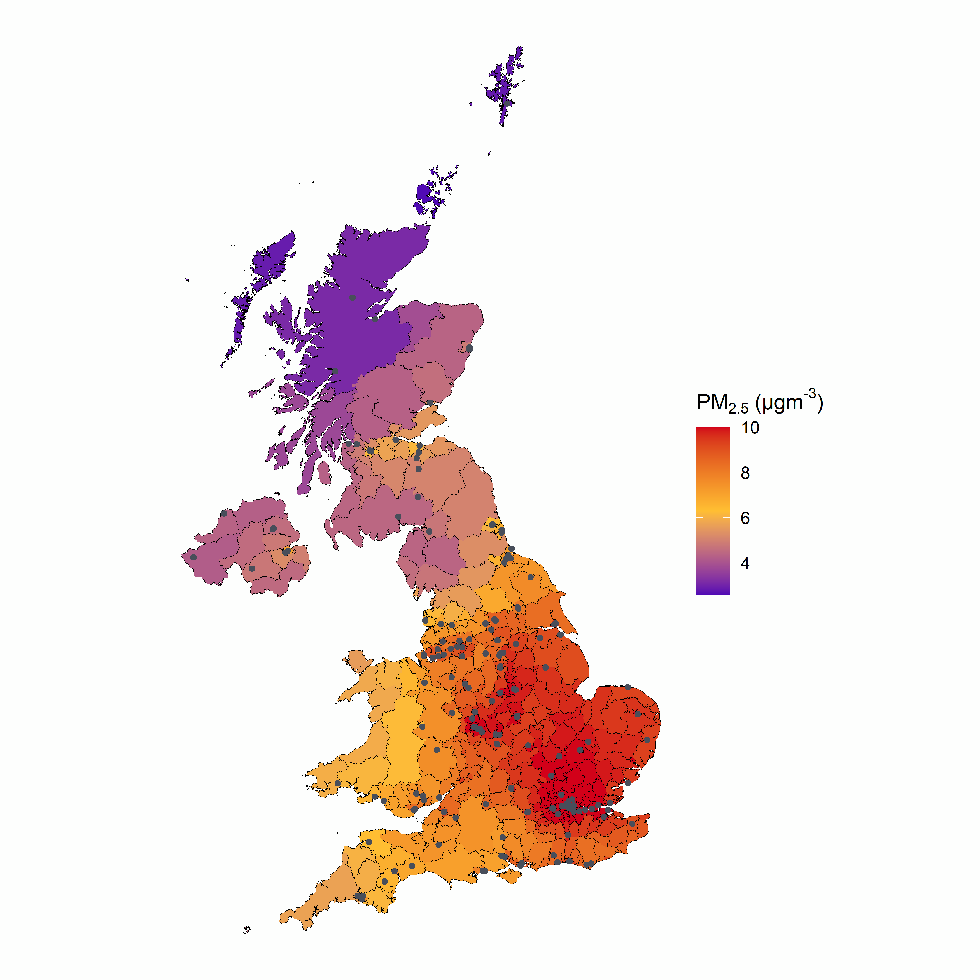
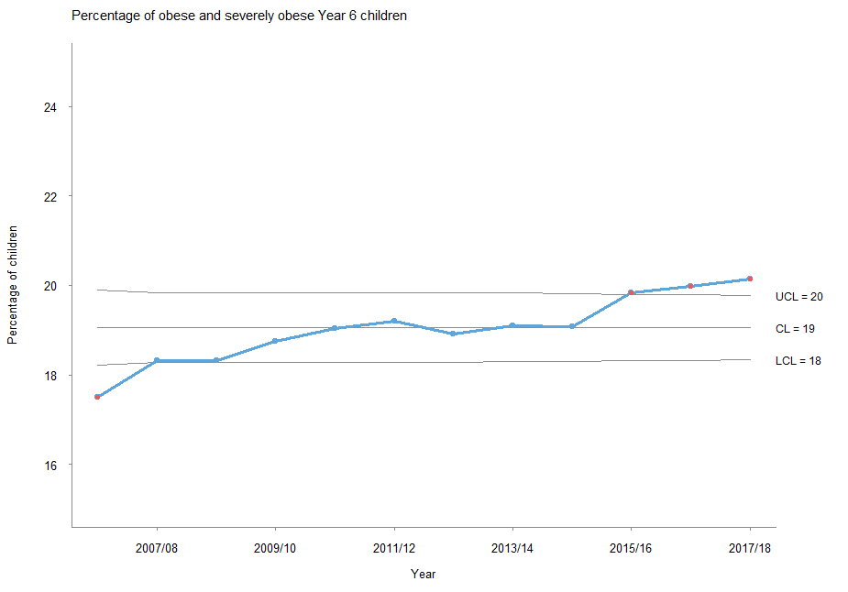
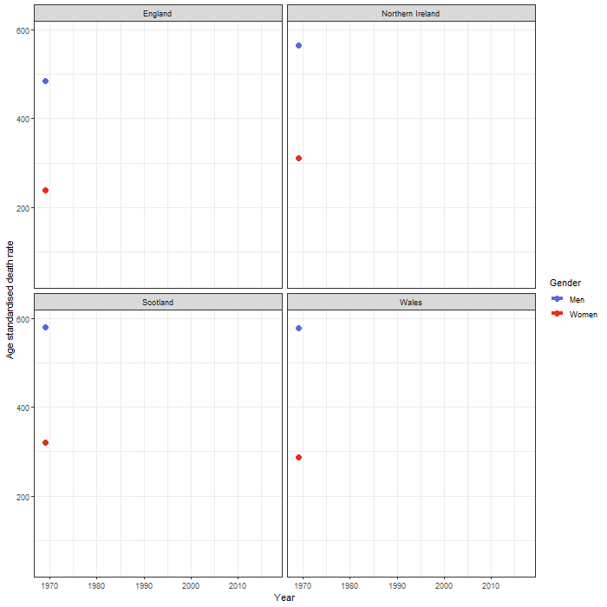
Understanding childhood obesity trends
Mapping air pollution across the UK for our campaign in late 2019
Errr….mucking about with GIFs of ASDRs
Notes:
Ok, admittedly not all of it was useful but this was a critical learning point for us.
By giving a bit of time to just have a play, get a bit creative, not only were we building skills but also building up new ideas and novel approaches. Having a bit of fun with R was time well spent,
On a more serious note, even just ‘dipping our toes’ we saw clear benefits:
Replicability obviously- the air pollution map for example has undergone updates and switches between parliamentary constituency and local authority versions that were quick and easy to realise once the core script was written
Speed of data wrangling- if I had a Damascene conversion on the road to R it was learning ‘gather’ in dplyr.

Slide 8
Stage 3: shoulders under, get moving
If I keep moving I’m far less likely to die…….….right?
Notes:
If I keep moving I’m far less likely to die….right?
Building on our smaller successes we started to become a bit more joined up. Most notably we brought together a number of insight and intelligence teams across the BHF to undertake some R basic training- that incorporated marketing, health intelligence and customer insight teams. In itself it was a team bonding experience (as far as remote training can be!) but it also gave us the beginnings of a shared language that helped to break down some internal silos.
We’ve developed a bit more to using R for whole projects rather than piecemeal- having a project to hang analyses off has I think been an important part of our journey. We’re able to create a whole analytical narrative with R; some of the scripts we have describe the whole project end to end.
Here’s a few examples……

Slide 9
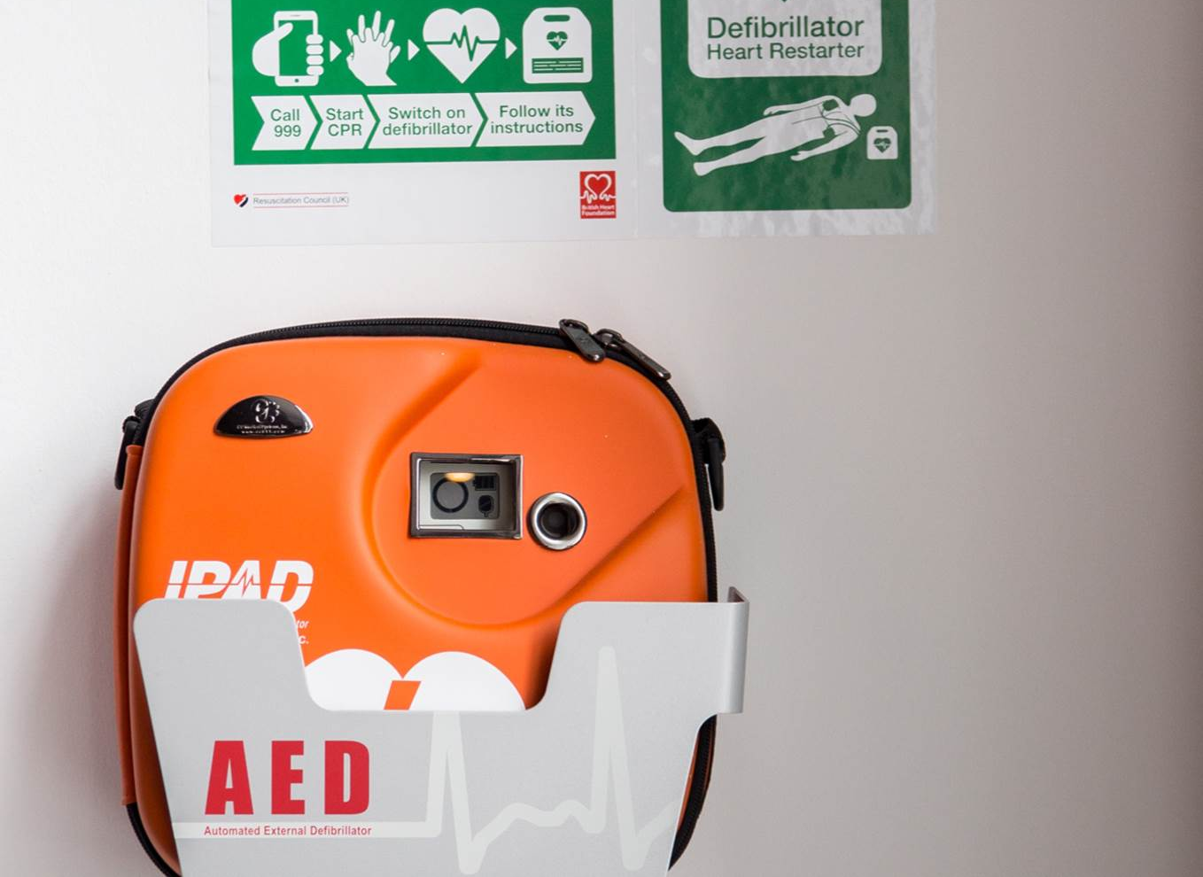
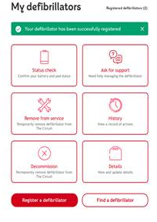
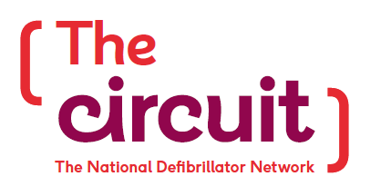
v
The Circuit
Notes:
We are leading on the roll-out of a national defibrillator data base to make sure these life saving devices are used to their full potential.
R has been used for:
Proof of concept for and approach linking location of defibs to Ambulance service geographies
Development of stratification for targeting of corporate defib owners (e.g. Premier Inn)

Slide 10
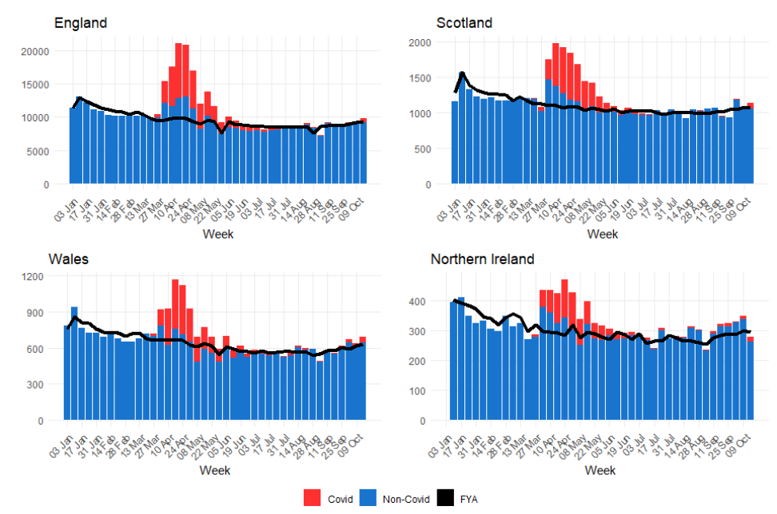
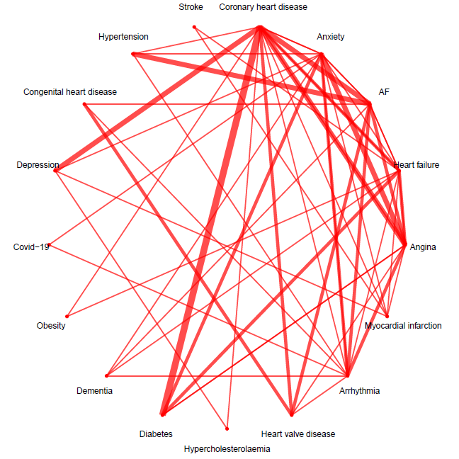
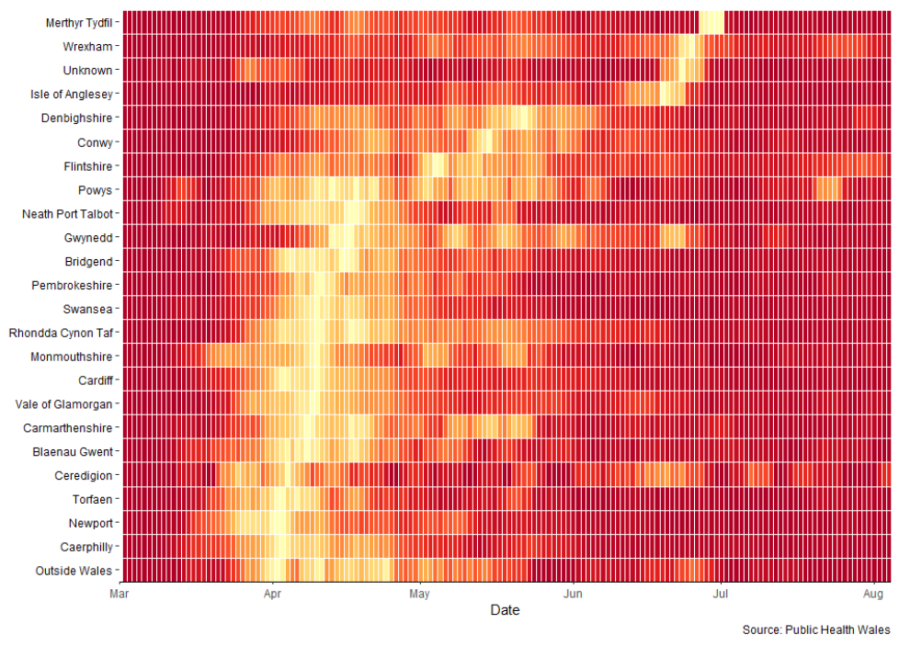
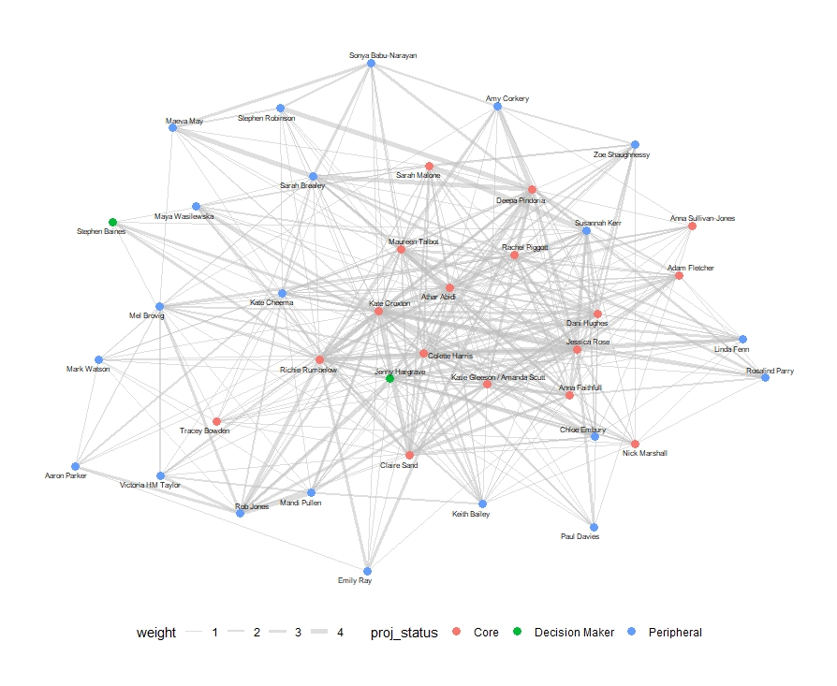
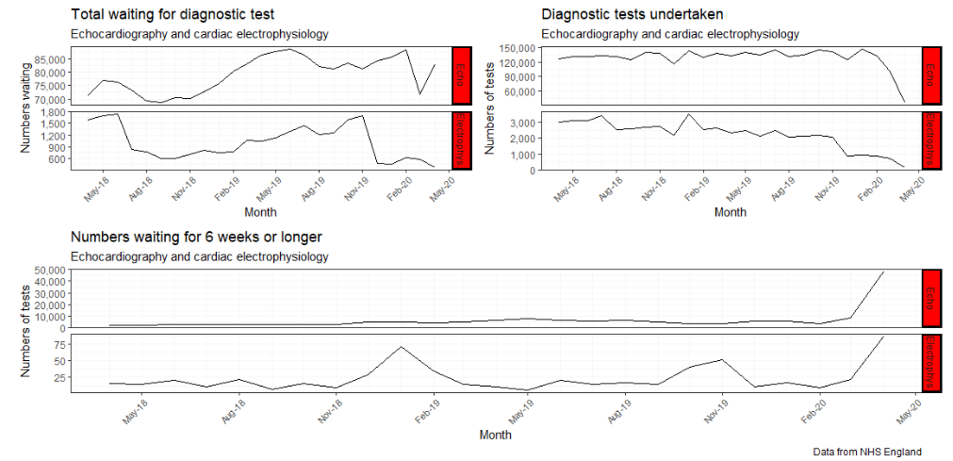
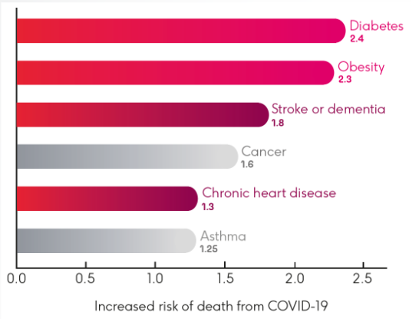
Notes:
Covid response:
Regular reporting- key stats and factsheets to support media work and fundraising
Tracking service issues and risk analysis for people with HCD
Understanding the heart helpline
Social network analysis for internal Covid response evaluation
Basic text analytics and sentiment analysis for indicative analysis of qualitative data gathered (not shown)
Considerable use of R markdown, including use of flexdashboard – some reports effectively automated
So we’re building on our replicability and speed benefits but at this stage the community really came into its own- special shout out to Colin Angus (@VictimofMaths) without whose willingness to share his code we’d never have got our core Covid report over the line; also Shirin Elsinghorst’s excellent series of blogs and tutorials on social network analysis in R using Games of Thrones data; she’ll never know how apt that model was ;).
We’ve also got work ongoing on propensity modelling for regular givers and a raft of smaller projects across the health intelligence portfolio.
Our key lesson here was to keep going- capitalise on the new skills from the team and commit to using R, even if, initially it might take a little bit more time. And also to sweat the resources that were out there- ask the stupid questions!

Slide 11
Stage 4: keeping warm
The endorphins are wearing off…… its all been terribly exciting but now my teeth are starting to chatter!
Notes:
The endorphins are wearing off…… its all been terribly exciting but now my teeth are starting to chatter!
So far, you might be tempted to think that the R journey is all grand and dandy back at BHF virtual HQ. But we have challenges in terms of shifting to the next gear.
R is just one tool in the proverbial analytical toolbox and although it has been identified as a strategic choice in our information strategy (which means there’s a piece of paper to wave at IT if they baulk at installing it!) its use means different things to different teams. In the BHF context it has ended up as being synonymous with ‘data science’ which means different things to different people and can translate into problems if we don’t have a ‘data science’ tag on a project. We wind up using it anyway, but it becomes a guerrilla enterprise rather than a scaling up of a useful tool.
This in turn has led to concerns with regard to safety; the enthusiasm and joy of discovery and use of new packages brings doesn’t always translate into good governance (hand up, very guilty…….). But we end up with a chicken and egg situation- shouldn’t be downloading packages willy nilly without appropriate governance and scrutiny, but without using these it can be hard to demonstrate the benefit. It’s been a major stumbling block on our development in Shiny- we want to use it (first off) for really simple, quick to develop and easy to maintain interface for interrogation of the wealth of qual insight that we generate. Alas, we don’t want it in the public domain, but have not yet successfully made the case for a Shiny Server that could support authentication. BHF is essentially a Microsoft house and its proving difficult to prove to colleagues that R provides us with the functionality and flexibility we need for critical elements of our analytical work than the current technology stack can afford.

Slide 12
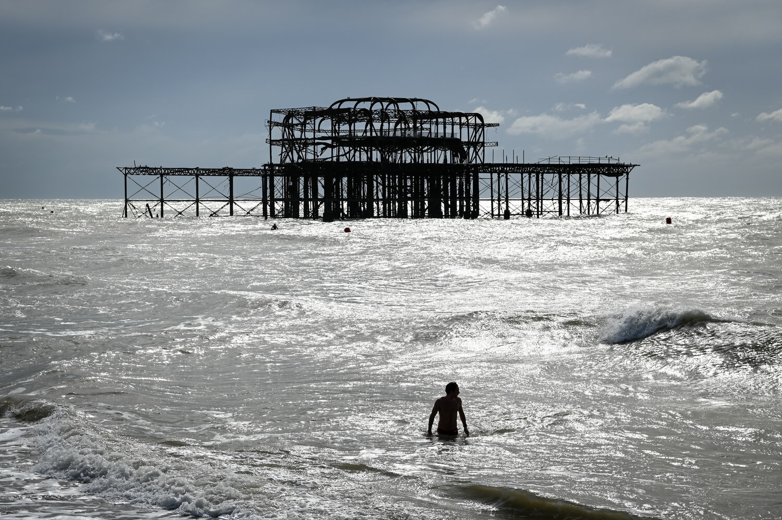
Notes:
To come back to our cold water swimming analogy, we are on the point of moving from swimming in a lake to throwing ourselves into the wide open ocean.
I think the future of R in the BHF is reasonably secure; we have made progress but it feels slightly fragile……
1. There is no question that R is part of OUR toolkit in Health Intelligence, but we are still way off having it as part of the BHF’s toolkit
2. We’re committed to sharing our approaches, across the charity sector and beyond and are hoping to establish a BHF R user group; but we’re probably a way off Jupyter notebooks and a Github repository.
Part of the reason I find events like this so valuable is to see the art of the possible and how far people have come in the intervening months.
If you are standing in front of a metaphorical body of cold water and scratching your head asking ‘what am I doing here?’, or even just dipping a toe, I hope that our story has helped in small way to show the art of the possible, and, if you’re thinking about returning to the warm house, presented enough of a reason to jump in!
Thanks

